Slide 1
Combinational Logic
Prepared By Dr. Sultan S. Alqahtani
CS106 Digital Logic

Slide 2
Introduction
We have learned all the prerequisite material:
– Truth tables and Boolean expressions describe functions
– Expressions can be converted into hardware circuits
– Boolean algebra and K-maps help simplify expressions and circuits
Now, let us put all of these foundations to good use, to analyze and design some larger circuits

Slide 3
Introduction
Logic circuits for digital systems may be
– Combinational
– Sequential
A combinational circuit consists of logic gates whose outputs at any time are determined by the current input values, i.e., it has no memory elements
A sequential circuit consists of logic gates whose outputs at any time are determined by the current input values as well as the past input values, i.e., it has memory elements

Slide 4
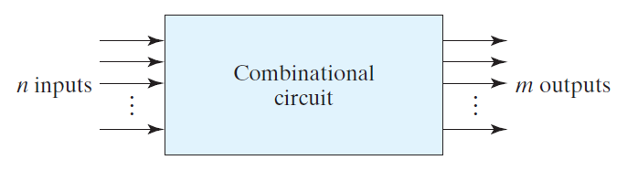
Combinational Circuits
Each input and output variable is a binary variable
2^n possible binary input combinations
One possible binary value at the output for each input combination
A truth table or m Boolean functions can be used to specify input-output relation

Slide 5
Design Hierarchy
A single very large-scale integrated (VLSI) processos circuit contains several tens of millions of gates!
Imagine interconnecting these gates to form the processor
No complex circuit can be designed simply by interconnecting gates one at a time
Divide and Conquer approach is used to deal with the complexity
– Break up the circuit into pieces (blocks)
– Define the functions and the interfaces of each block such that the
circuit formed by interconnecting the blocks obeys the original circuit specification
– If a block is still too large and complex to be designed as a single entity, it can be broken into smaller blocks

Slide 6
Divide and Conqure

Slide 7
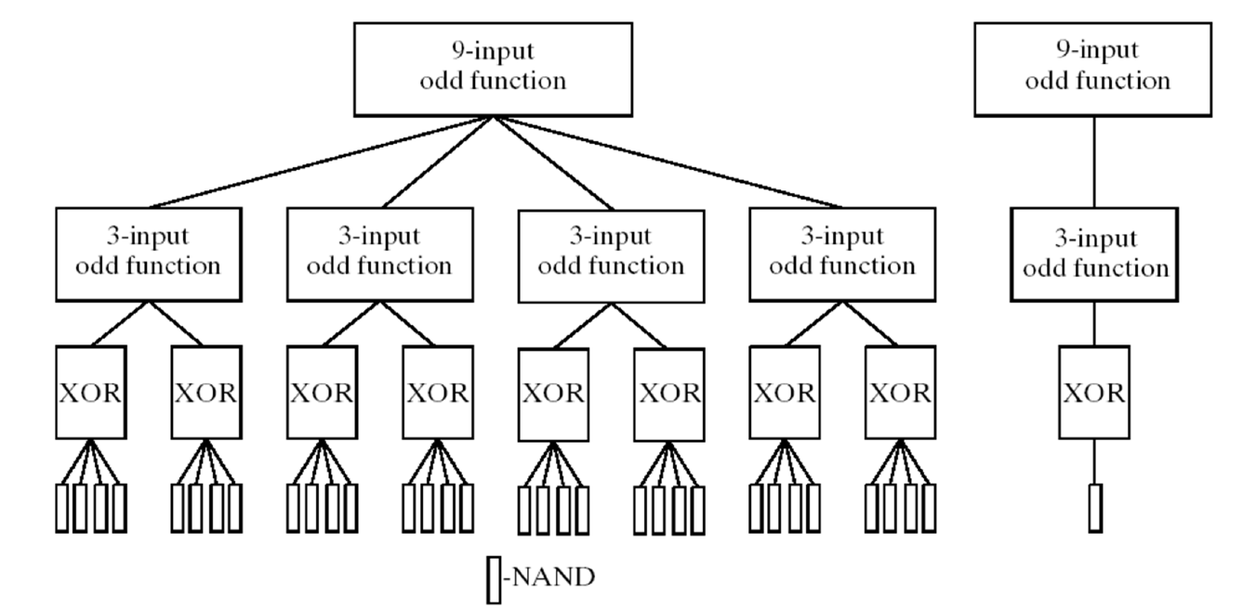
Hierarchical Design due to Divide and Conquer

Slide 8
Design Procedure
The design of a combinational circuit involves the following steps:
– Specification: How the circuit operates is clearly expressed
– Formulation: Derivation of the truth table or the Boolean equations that define the relationship between inputs and outputs
– Optimization: Algebraic or K-map optimization of the truth table and draw the corresponding logic diagram
– Technology Mapping: Transform the logic diagram to a new diagram using the available implementation technology
– Verification: Verify the correctness of the final design

Slide 9
Exercise: Comparing 2-bit Numbers
Let’s design a circuit that compares two 2-bit numbers, A and B. The circuit should have three outputs:
– G (“Greater”) should be 1 only when A > B
– E (“Equal”) should be 1 only when A = B
– L (“Lesser”) should be 1 only when A < B

Slide 10
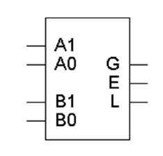
Comparing 2-bit Numbers: Specification
Make sure you understand the problem
– Inputs A and B will be 00, 01, 10, or 11 (0, 1, 2 or 3 in decimal)
For any inputs A and B, exactly one of the three outputs will be 1
Two 2-bit numbers means a total of four inputs
– We should name each of them
– Let’s say the first number consists of digits A1 and A0 from left to right, and the second number is B1 and B0
The problem specifies three outputs: G, E and L

Slide 11
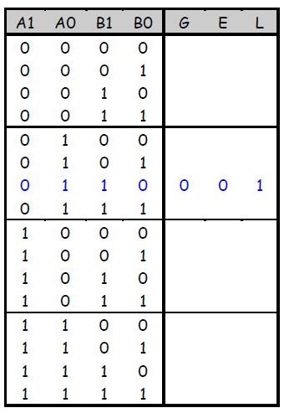
Comparing 2-bit Numbers: Formulation
For this problem, it’s probably easiest to start with a truth table. This way, we can explicitly show the relationship (>, =, <) between inputs
A four-input function has a sixteen-row truth table
It’s usually clearest to put the truth table rows in binary numeric order; in this case, from 0000 to 1111 for A1, A0, B1 and B0
Example: 01 < 10, so the sixth row of the truth table (corresponding to inputs A=01 and B=10) shows that output L=1, while G and E are both 0.

Slide 12
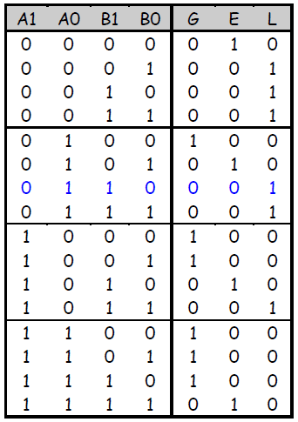
Comparing 2-bit Numbers: Formulation

Slide 13
Comparing 2-bit Numbers: Optimization
Let’s use K-maps. There are three functions (each with the same inputs A1 A0 B1 B0), so we need three K-maps
B1 B0
B1 B0
B1 B0
A1 A0
00
01
11
10
A1 A0
00
01
11
10
A1 A0
00
01
11
10
00
0
0
0
0
00
00
01
1
0
0
0
01
01
11
1
1
0
1
11
11
10
1
1
0
0
10
10
G(A1 ,A0, B1 ,B0) = ?
E(A1 ,A0, B1 ,B0) = ?
L(A1 ,A0, B1 ,B0) = ?

Slide 14
Comparing 2-bit Numbers: Optimization
G = A1 A0 B0’ + A0 B1’ B0’ + A1 B1’
E = A1’ A0’ B1’ B0’ + A1’ A0 B1’ B0 + A1 A0 B1 B0 + A1 A0’ B1 B0’
L = A1’ A0’ B0 + A0’ B1 B0 + A1’ B1

Slide 15
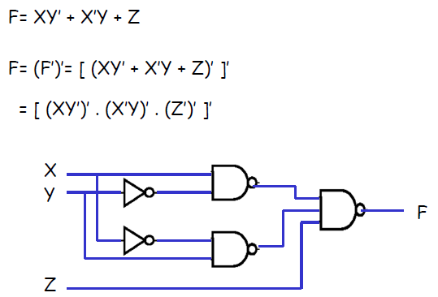
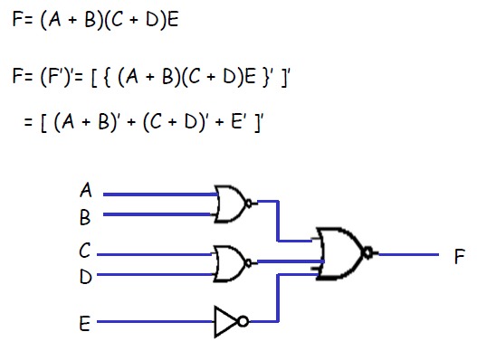
Technology Mapping
NAND gate implementation
Goal: use only NAND gates to implement the circuits
NOR gate implementation
Goal: use only NOR gates to implement the circuits

Slide 16
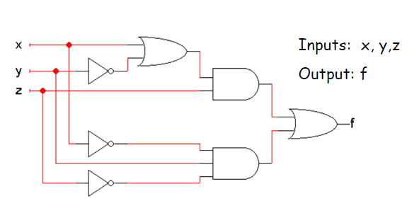
Verification – circuits Analysis
Circuit analysis involves figuring out what some circuit does
– Every circuit computes some function, which can be described with Boolean expressions or truth tables
– So, the goal is to find an expression or truth table for the circuit
The first thing to do is to figure out what the inputs and outputs of the overall circuit are

Slide 17
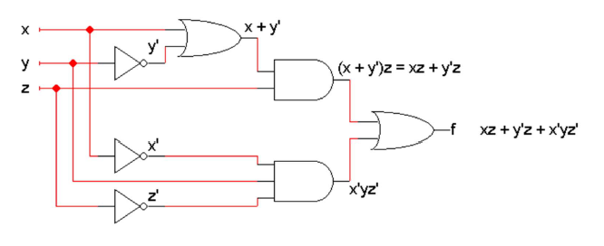
Verification – circuits Analysis
Write expressions for the outputs of each individual gate, based on that gate’s inputs
– Start from the inputs and work towards the outputs
– It might help to do some algebraic simplification along the way

Slide 18
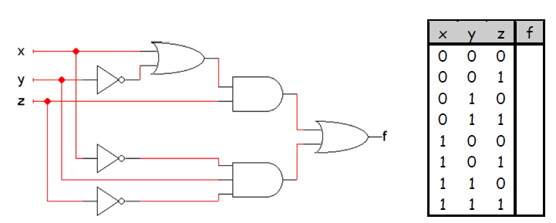

Verification – circuits Analysis
It’s also possible to find a truth table directly from the circuit.
Once you know the number of inputs and outputs, list all the possible input combinations in your truth table
– A circuit with n inputs should have a truth table with $2^{n}$ rows

Slide 19
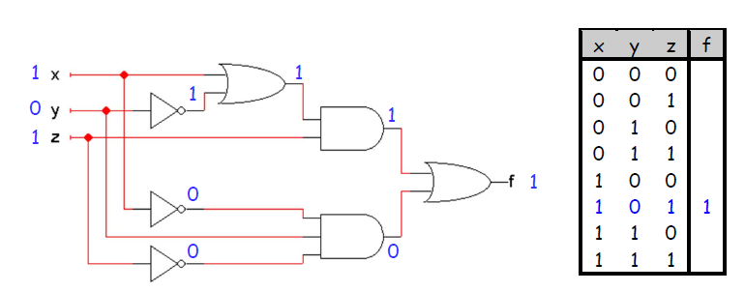
Verification – circuits Analysis
You can simulate the circuit by hand to find the output for each possible combination of inputs

Slide 20
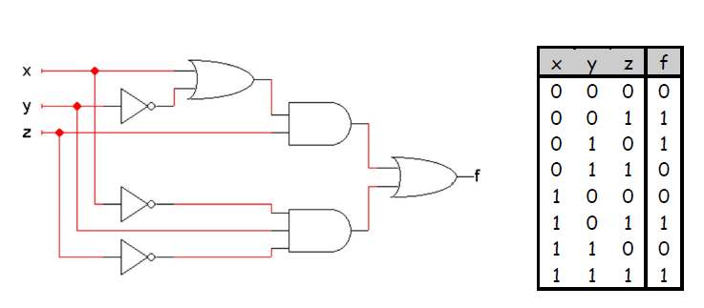
Verification – circuits Analysis
Doing the same thing for all the other input combinations yields the complete truth table
This is simple, but tedious

Slide 21
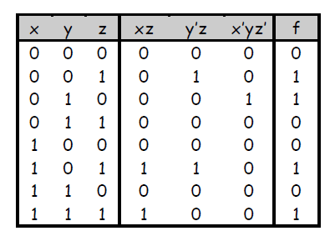
Verification – circuits Analysis
Remember that if you already have a Boolean expression, you can use that to easily make a truth table
For example, since we already found that the circuit computes the function f(x,y,z) = xz + y’z + x’yz’, we can use that to fill in a table:

Slide 22
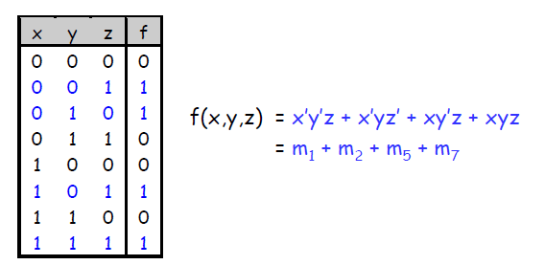
Verification – circuits Analysis
The opposite is also true: it’s easy to come up with an expression if you already have a truth table
Convert a truth table into a sum of minterms expression
You can then simplify this sum of minterms if desired—using a K-map, for example

Slide 23
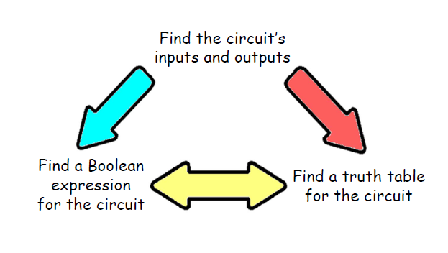
Circuits Analysis Summary
After finding the circuit inputs and outputs, you can come up with either an expression or a truth table to describe what the circuit does
You can easily convert between expressions and truth tables

Slide 24
Extra Examples (Reading)
BCD-to-Excess-3 Code Converter
4-Bit Equality Comparator

Slide 25
BCD-to-Excess-3 Code Converter
The excess-3 code for a decimal digit is the binary combination corresponding to the decimal digit plus 3. For example, the excess-3 code for decimal digit 5 is the binary combination for 5 + 3 = 8, which is 1000.
Each BCD digit is four bits with the bits, from most significant to least significant, labeled A, B, C, D. Each excess-3 digit is four bits, with the bits, from most significant to least significant, labeled W, X, Y, Z.

Slide 26
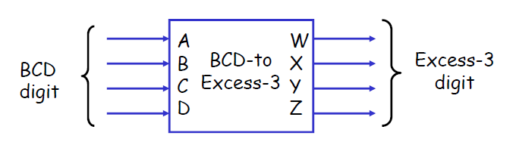
BCD-to-Excess-3 Code Converter - Specification

Slide 27
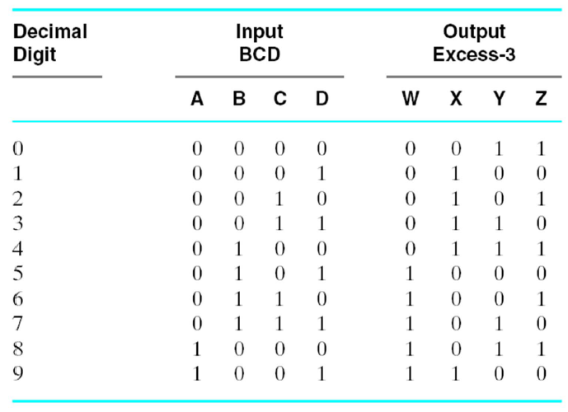
BCD-to-Excess-3 Code Converter – Formulation

Slide 28
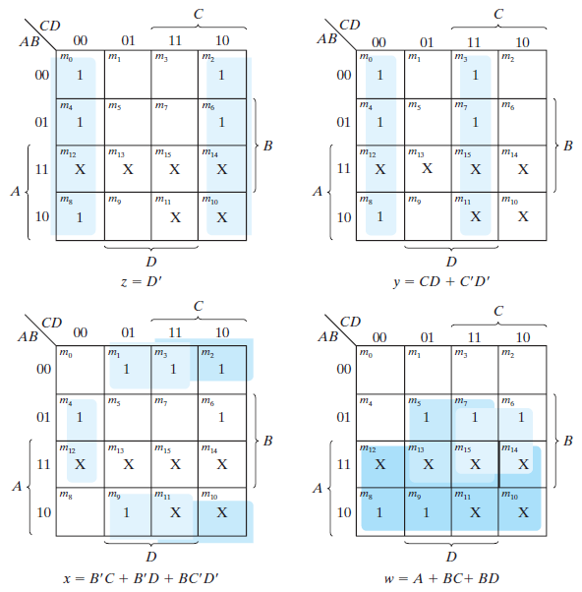
BCD-to-Excess-3 Code Converter – Optimization

Slide 29
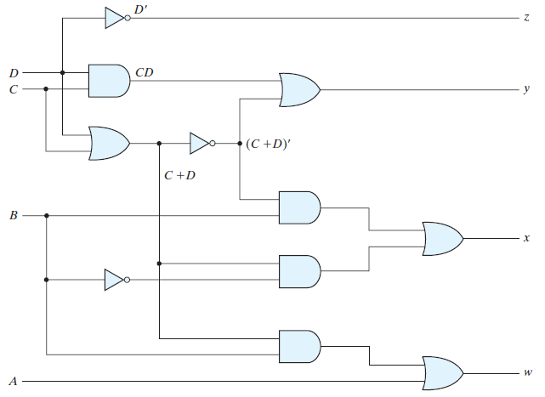
BCD-to-Excess-3 Code Converter – Optimization

Slide 30
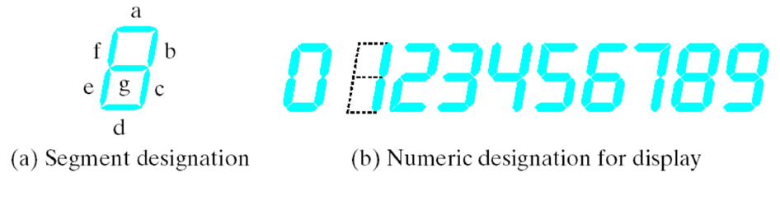
BCD-to-Seven-Segment Decoder
H.W ☹
Digital readouts found in many consumer electronic products often use Light Emitting Diodes (LEDs). Each digit of the readout is formed from seven LED segments. Each segment can be illuminated by a digital signal. A BCD-to-seven segment decoder is a combinational circuit that accepts a decimal digit in BCD and generates the appropriate outputs for the segments of the display for the decimal digit. The seven outputs of the decoder (a,b,c,d,e,f,g) select the corresponding segments in the display. BCD-to-seven-segment decoder has four inputs, A, B, C, and D for the BCD digit and seven outputs, a through g, for controlling the segments.

Slide 31
Half Adder and Full Adders

Slide 32
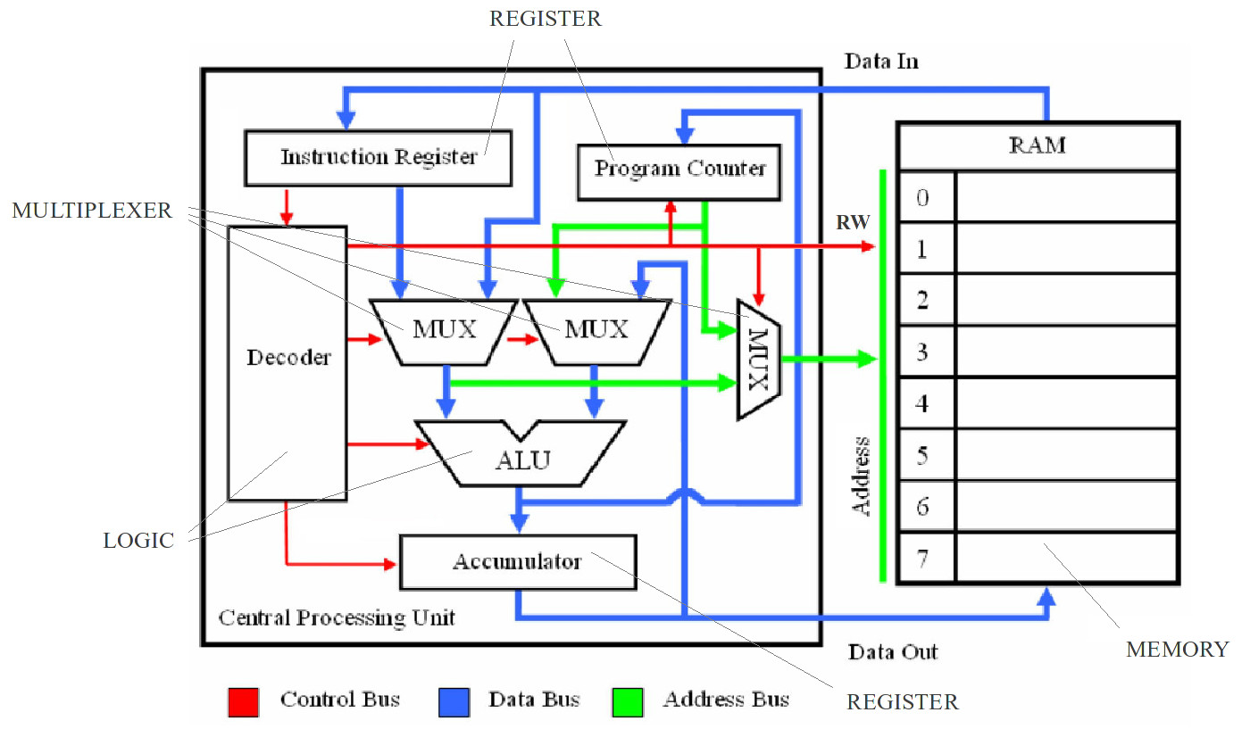
Before we start

Slide 33
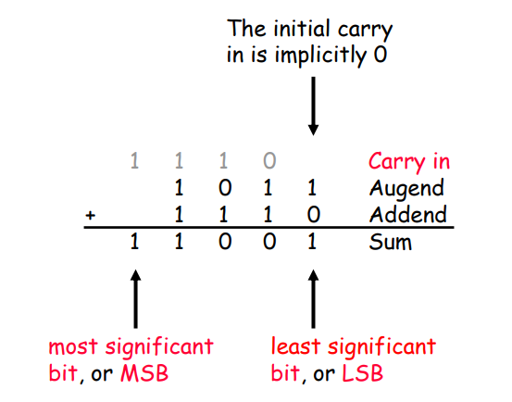
Binary Addition by Hand
You can add two binary numbers one column at a time starting from the right, just as you add two decimal numbers
But remember that it’s binary. For example, 1 + 1 = 10 and you have to carry!

Slide 34
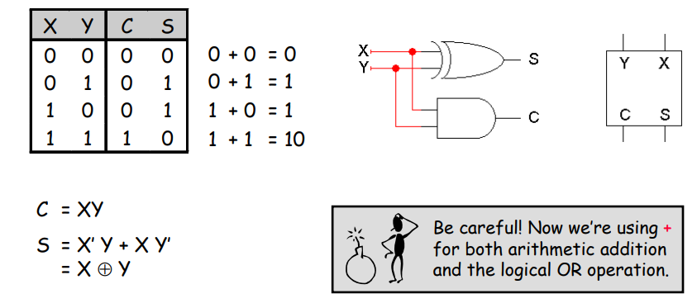
Adding Two Bits
A hardware adder by copying the human addition algorithm
Half adder: Adds two bits and produces a two-bit result: a sum (the right bit) and a carry out (the left bit)
Here are truth tables, equations, circuit and block symbol

Slide 35
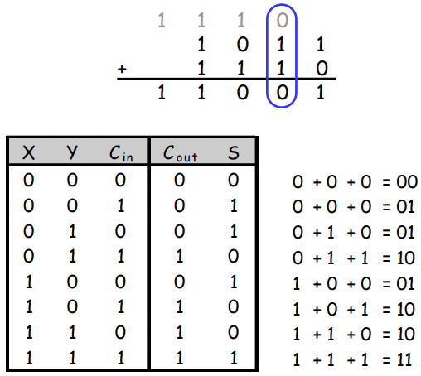
Adding Three Bits
But what we really need to do is add three bits: the augend and addend, and the carry in from the right.

Slide 36
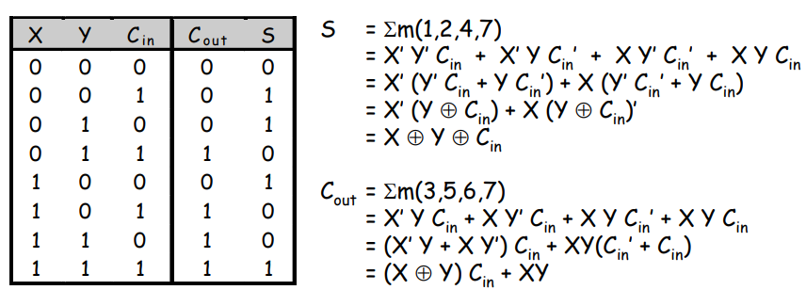
Full Adder
Full adder: Three bits of input, two-bit output consisting of a sum and a carry out
Using Boolean algebra, we get the equations shown here
XOR operations simplify the equations a bit
We used algebra because you can’t easily derive XORs from K-maps

Slide 37
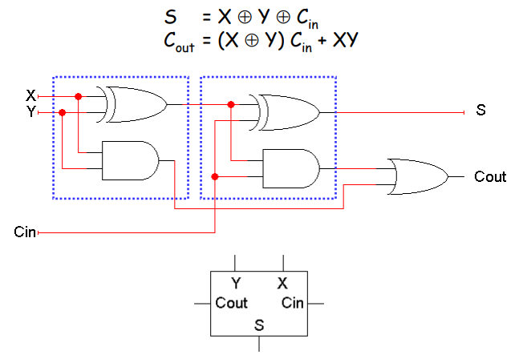
Full Adder Circuit
These things are called half adders and full adders because you can build a full adder by putting together two half adders!

Slide 38
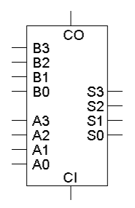
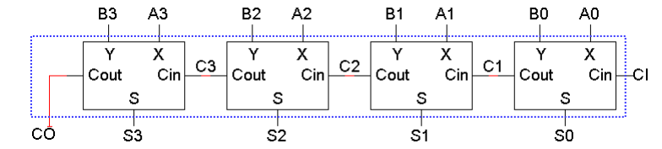
A 4-bit Adder
Four full adders together make a 4-bit adder
There are nine total inputs:
-Two 4-bit numbers, A3 A2 A1 A0 and B3 B2 B1 B0
-An initial carry in, CI
The five outputs are:
– A 4-bit sum, S3 S2 S1 S0
– A carry out, CO

Slide 39
Imagine designing a nine-input adder without this hierarchical structure— you’d have a 512-row truth table with five outputs!

Slide 40
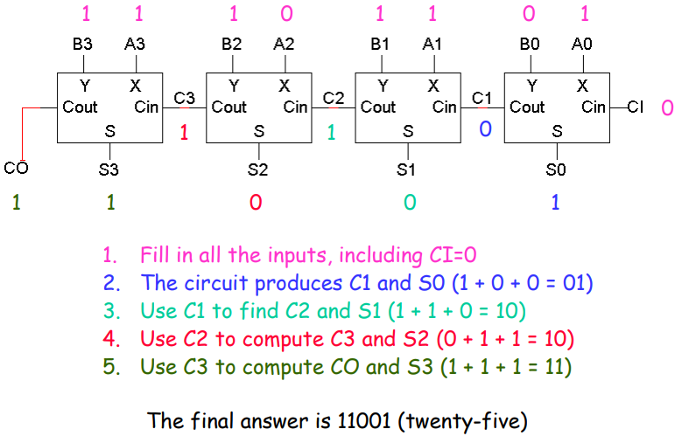
An example of 4-bit addition
Let’s try our initial example: A=1011 (eleven), B=1110 (fourteen)

Slide 41
Overflow
In this case, note that the answer (11001) is five bits long, while the inputs were each only four bits (1011 and 1110). This is called overflow
Although the answer 11001 is correct, we cannot use that answer in any subsequent computations with this 4-bit adder
For unsigned addition, overflow occurs when the carry out is 1

Slide 42
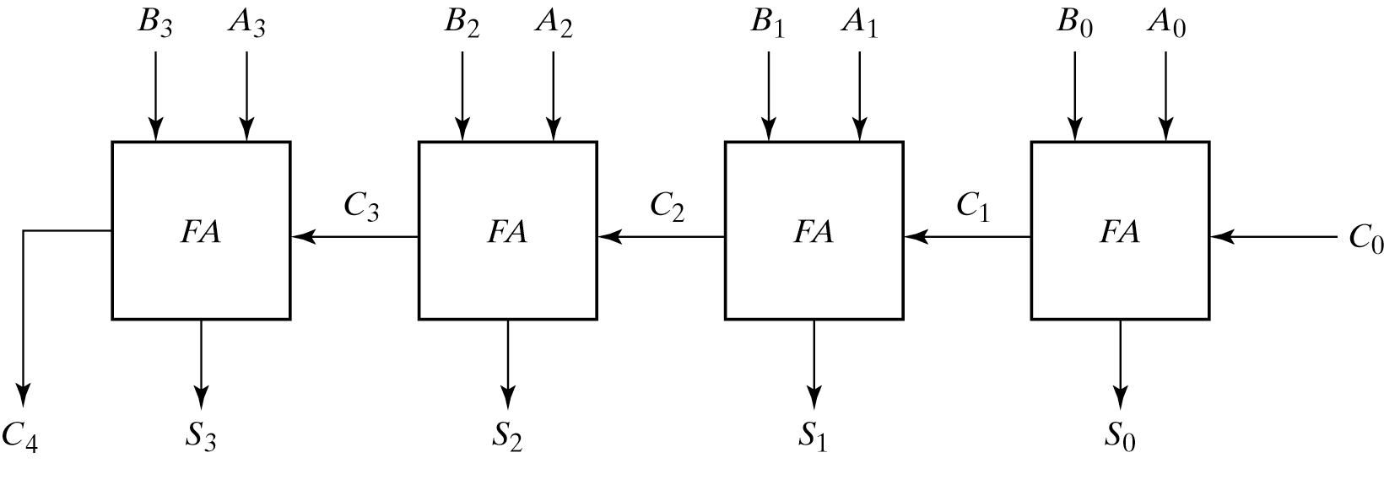
Another example
Input carry C_{i} 1 1 1 0
Augend A_{i} 0 1 0 1
Addend B_{i} 0 1 1 1
Sum S_{i} 1 1 0 0
Output carry C_{i+1} 0 1 1 1

Slide 43
Making a subtraction circuit
We could build a subtraction circuit directly, similar to the way we made unsigned adders
However, by using two’s complement we can convert any subtraction problem into an addition problem. Algebraically,
A - B = A + (-B)
So to subtract B from A, we can instead add the negation of B to A
This way we can re-use the unsigned adder hardware

Slide 44
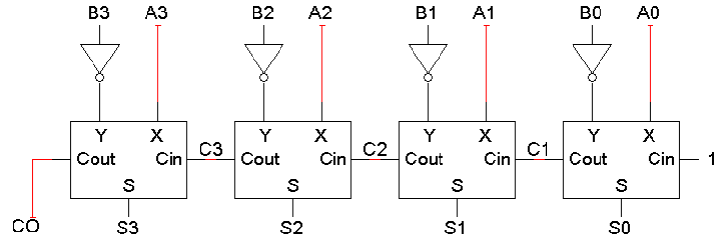
A two’s complement subtraction circuit
To find A - B with an adder, we’ll need to:
– Complement each bit of B
– Set the adder’s carry in to 1
The net result is A + B’ + 1, where B’ + 1 is the two’s complement negation of B
Remember that A3, B3 and S3 here are actually sign bits

Slide 45
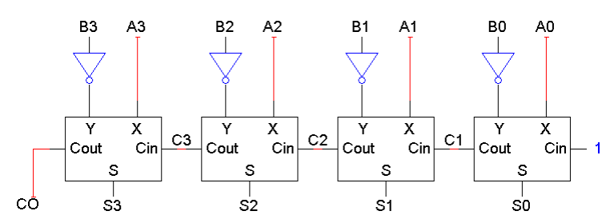
Small differences
The only differences between the adder and subtractor circuits are:
- The subtractor has to negate B3 B2 B1 B0
The subtractor sets the initial carry in to 1, instead of 0
Not too hard to make one circuit that does both addition and subtraction

Slide 46
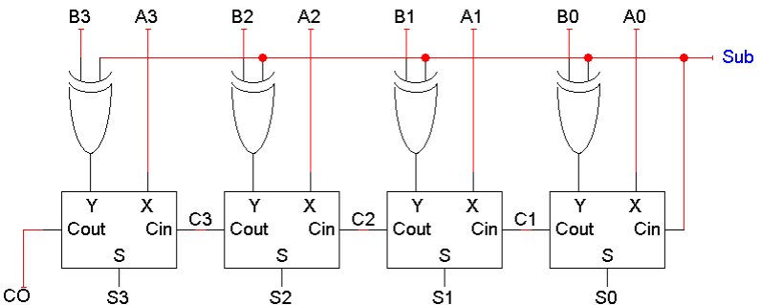
An Adder-Subtractor Circuit
XOR gates let us selectively complement the B input
X ⊕ 0 = X X ⊕ 1 = X’
When Sub = 0, the XOR gates output B3 B2 B1 B0 and the carry in is 0. The adder output will be A + B + 0, or just A + B
When Sub = 1, the XOR gates output B3’ B2’ B1’ B0’ and the carry in is 1. Thus, the adder output will be a two’s complement subtraction, A - B
When Sub=0, the circuit is an adder. We have B⊕0=B. The output is A plus B.
When Sub=1, the circuit becomes a subtractor

Slide 47
Decoding and Encoding

Slide 48
Decoding
Decoding is the conversion of an n-bit input code to an m-bit output code with n ≤ m ≤ 2^{n} such that each valid code word produces a unique output code
Circuits that perform decoding are called decoders

Slide 49
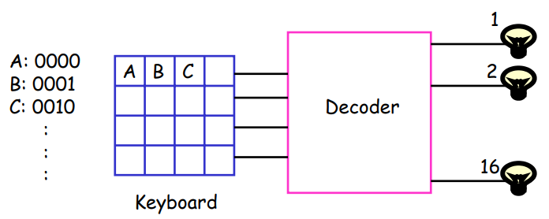
What is a decoder?
Decoder: A combinational circuit with an n-bit binary code applied to its inputs and m-bit binary code appearing at the outputs
– n ≤ m ≤ 2^n
– Detect which of the 2^n combinations is represented at the inputs
– Produce m outputs, only one of which is “1”

Slide 50
Decoders are important combinational circuits.
Among other things, they are useful in selecting a memory location according a binary value placed on the address lines of a memory bus.
Address decoders with n inputs can select any of 2^{n} locations.

Slide 51
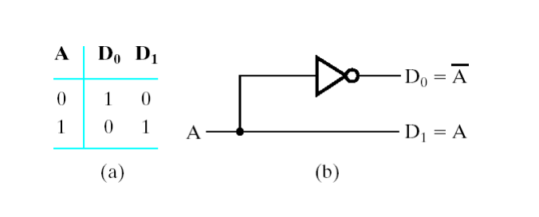
1-to-2 (Line) Decoder

Slide 52
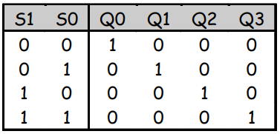
2-to-4 Decoder
A 2-to-4 decoder operates according to the following truth table
-The 2-bit input is called S1S0, and the four outputs are Q0-Q3
– If the input is the binary number i, then output Qi is uniquely true
For instance, if the input S1 S0 = 10 (decimal 2), then output Q2 is true, and Q0, Q1, Q3 are all false
This circuit “decodes” a binary number into a “one-of-four” code

Slide 53
How can you build 2-to-4 decoder?
Follow the design procedures from last time! We have a truth table, so we can write equations for each of the four outputs (Q0-Q3)
In this case there’s not much to be simplified. Here are the equations:
Q0 = S1’ S0’
Q1 = S1’ S0
Q2 = S1 S0’
Q3 = S1 S0

Slide 54
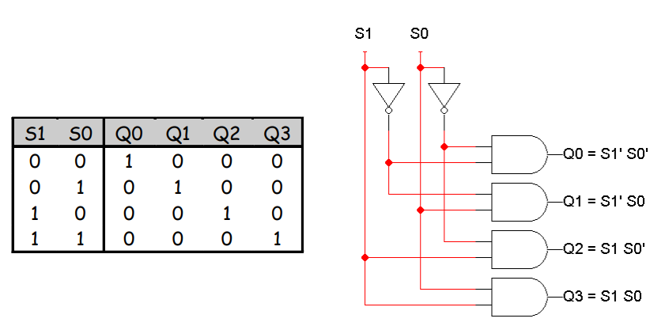
2-to-4 Decoder

Slide 55
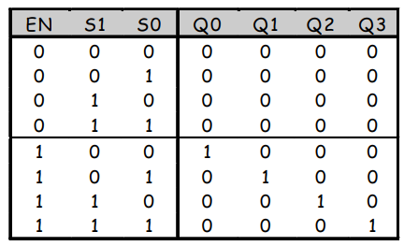
Enable Inputs
Many devices have an additional enable input, which is used to “activate” or “deactivate” the device
For a decoder,
– EN=1 activates the decoder, so it behaves as specified earlier. Exactly one of the outputs will be 1
– EN=0 “deactivates” the decoder. By convention, that means all of the decoder’s outputs are 0
We can include this additional input in the decoder’s truth table:

Slide 56
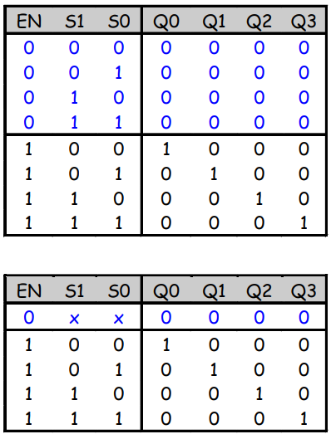
An aside: abbreviation truth tables
In this table, note that whenever EN=0, the outputs are always 0, regardless of inputs S1 and S0.
We can abbreviate the table by writing x’s in the input columns for S1 and S0

Slide 57
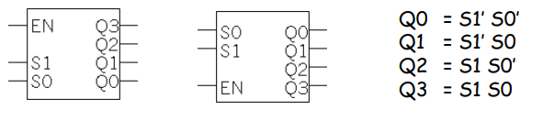
Blocks and Abstraction
Decoders are common enough that we want to encapsulate them and treat them as an individual entity
Block diagrams for 2-to-4 decoders are shown here. The names of the inputs and outputs, not their order, is what matters.
A decoder block provides abstraction:
– You can use the decoder as long as you know its truth table or equations, without knowing exactly what’s inside
– It makes diagrams simpler by hiding the internal circuitry
– It simplifies hardware reuse. You don’t have to keep rebuilding the decoder from scratch every time you need it
These blocks are like functions in programming!

Slide 58
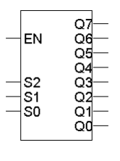
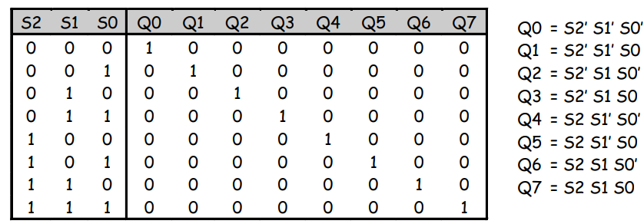
3-to-8 decoder
Larger decoders are similar. Here is a 3-to-8 decoder
– The block symbol is on the right
– A truth table (without EN) is below
– Output equations are at the bottom right
Again, only one output is true for any input combination

Slide 59
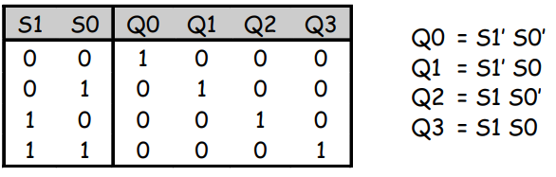
So what good is a decoder?
Do the truth table and equations look familiar?
Decoders are sometimes called minterm generators
– For each of the input combinations, exactly one output is true
– Each output equation contains all of the input variables
– These properties hold for all sizes of decoders
Arbitrary functions can be implemented with decoders. If a sum of minterms equation for a function is given, a decoder (a minterm generator) is used to implement that function

Slide 60
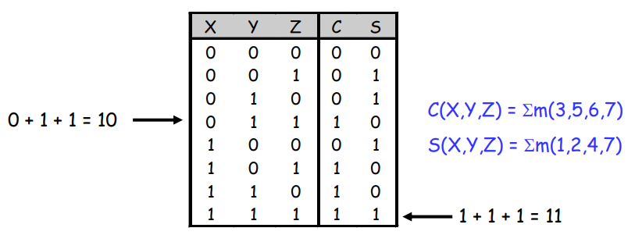
Design example: Addition
Let’s make a circuit that adds three 1-bit inputs X, Y and Z
We will need two bits to represent the total; let’s call them C and S, for “carry” and “sum.” Note that C and S are two separate functions of the same inputs X, Y and Z
Here are a truth table and sum-of-minterms equations for C and S

Slide 61
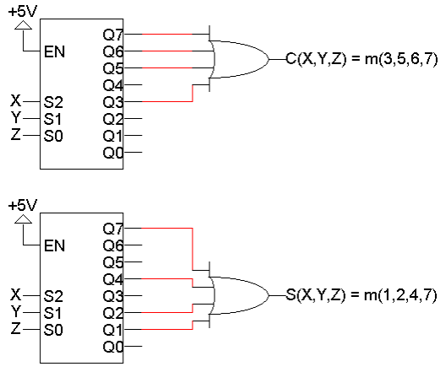
Decoder-based Adder
Here, two 3-to-8 decoders implement C and S as sums of minterms.

Slide 62
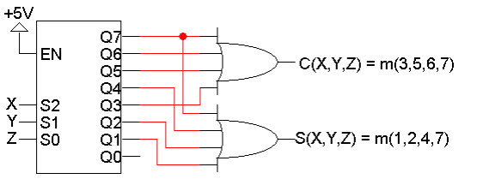
Using just one decoder
Since the two functions C and S both have the same inputs, we could use just one decoder instead of two.

Slide 63
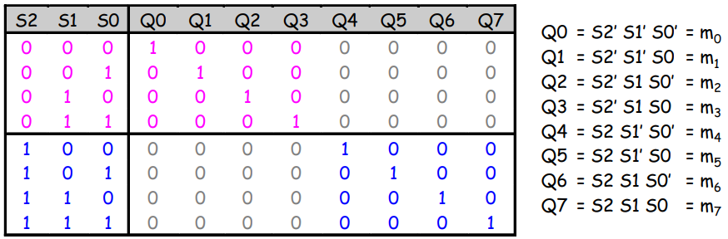
Building a 3-to-8 decoder
You could build a 3-to-8 decoder directly from the truth table and equations below, just like how we built the 2-to-4 decoder
Another way to design a decoder is to break it into smaller pieces
Notice some patterns in the table below:
– When S2 = 0, outputs Q0-Q3 are generated as in a 2-to-4 decoder
- When S2 = 1, outputs Q4-Q7 are generated as in a 2-to-4 decoder

Slide 64
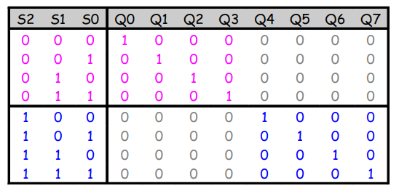
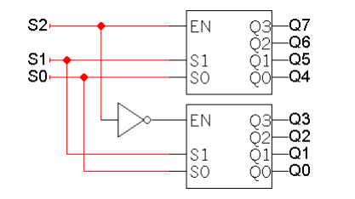
Decoder Expansion
You can use enable inputs to string decoders together. Here’s a 3-to-8 decoder constructed from two 2-to-4 decoders:

Slide 65

4-to-16-line Decoder

Slide 66

Problem
We need 4x16 decoder. You have OLNY 2X4 decoders. How you are going to design that?

Slide 67
Encoding
Encoding is the opposite of decoding - the conversion of an m-bit input code to a n-bit output code with n ≤ m ≤2^{n} such that each valid code word produces a unique output code
Circuits that perform encoding are called encoders
An encoder has 2^{n} (or fewer) input lines and n output lines which generate the binary code corresponding to the input values
Typically, an encoder converts a code containing exactly one bit that is 1 to a binary code corresponding to the position in which the 1 appears.

Slide 68

Encoder (cont.)
Octal-to-Binary Encoder: This encoder has eight inputs, one for each of the octal digits, and three outputs that generate the corresponding binary number
– Only one input can have the value of 1 at any given time

Slide 69

Octal-to-Binary Encoder
A0= D1 + D3 + D5 + D7
A2= D4 + D5 + D6 + D7
A1= D2 + D3 + D6 + D7

Slide 70
Multiplexers

Slide 71

Multiplexers
Multiplexers, or muxes, are used to choose between resources
A real-life example: in the old days before networking, several computers could share one printer through the use of a switch.

Slide 72


Multiplexers
A $2^{n}$-to-1 multiplexer sends one of $2^{n}$ input lines to a single output line
– A multiplexer has two sets of inputs:
* $2^{n}$ data input lines
* n select lines, to pick one of the $2^{n}$ data inputs
– The mux output is a single bit, which is one of the $2^{n}$ data inputs
The simplest example is a 2-to-1 mux:
The select bit S controls which of the data bits D0-D1 is chosen:
If S=0, then D0 is the output (Q=D0).
If S=1, then D1 is the output (Q=D1).

Slide 73


More truth table abbreviations
Here is a full truth table for this 2-to-1 mux, based on the equation:
Here is another kind of abbreviated truth table
– Input variables appear in the output column
– This table implies that when S=0, the output Q=D0, and when S=1 the output Q=D1
– This is a pretty close match to the equation

Slide 74

2-to-1-line Multiplexer

Slide 75

Implementing functions with multiplexers
Muxes can be used to implement arbitrary functions
One way to implement a function of n variables is to use an 2^n-to-1 mux:
- For each minterm mi of the function, connect 1 to mux data input Di. Each data input corresponds to one row of the truth table
– Connect the function’s input variables to the mux select inputs. These are used to indicate a particular input combination
For example, let’s look at f(x,y,z) = Σm(1,2,6,7)

Slide 76

A more efficient way
We can actually implement f(x,y,z) = Σm(1,2,6,7) with just a 4-to-1 mux, instead of an 8-to-1
Step 1: Find the truth table for the function, and group the rows into pairs. Within each pair of rows, x and y are the same, so f is a function of z only.
– When xy=00, f=z
– When xy=01, f=z’
– When xy=10, f=0
– When xy=11, f=1

Slide 77

A more efficient way
Step 2: Connect the first two input variables of the truth table (here, x and y) to the select bits S1 S0 of the 4-to-1 mux.
Step 3: Connect the equations above for f(z) to the data inputs D0-D3.

Slide 78

Example: multiplexer-based adder
Let’s implement the adder carry function, C(X,Y,Z), with muxes
There are three inputs, so we’ll need a 4-to-1 mux
The basic setup is to connect two of the input variables (usually the first two in the truth table) to the mux select inputs

Slide 79

Multiplexer-based carry
We can set the multiplexer data inputs D0-D3, by fixing X and Y and finding equations for C in terms of just Z.

Slide 80

Multiplexer-based sum
Here’s the same thing, but for the sum function S(X,Y,Z)

Slide 81

4-to-1-line Multiplexer

Slide 82

Dual multiplexer-based full adder
We need two separate 4-to-1 muxes: one for C and one for S
But sometimes it’s convenient to think about the adder output as being a single 2-bit number, instead of as two separate functions
A dual 4-to-1 mux gives the illusion of 2-bit data inputs and outputs
– It’s really just two 4-to-1 muxes connected together

Slide 83

Dual muxes in more detail
You can make a dual 4-to-1 mux by connecting two 4-to-1 muxes. (“Dual” means “two-bit values.”)
In the diagram on the right, we’re using S1-S0 to choose one of the following pairs of inputs:
– 2D3 1D3, when S1 S0 = 11
– 2D2 1D2, when S1 S0 = 10
– 2D1 1D1, when S1 S0 = 01
– 2D0 1D0, when S1 S0 = 00

Slide 84

Boolean Function Implementation
Consider the Boolean function, F(x, y, z) = Σ(1, 2, 6, 7)

Slide 85



Exercise
Consider the Boolean function, F(a,b,c,d) = Σ(1,3,4,7,12,13,15)
Use 16x1 mux
Use 8x1 mux
Use 4x1 mux

Slide 86
Conclusion
Design procedure
Half- and Full- Adders
Decoding and Encoding
Multiplexers

